Slide 1
Learning Bacterial Response
Umut Caglar UT Austin (Wilke Lab)

Slide 2
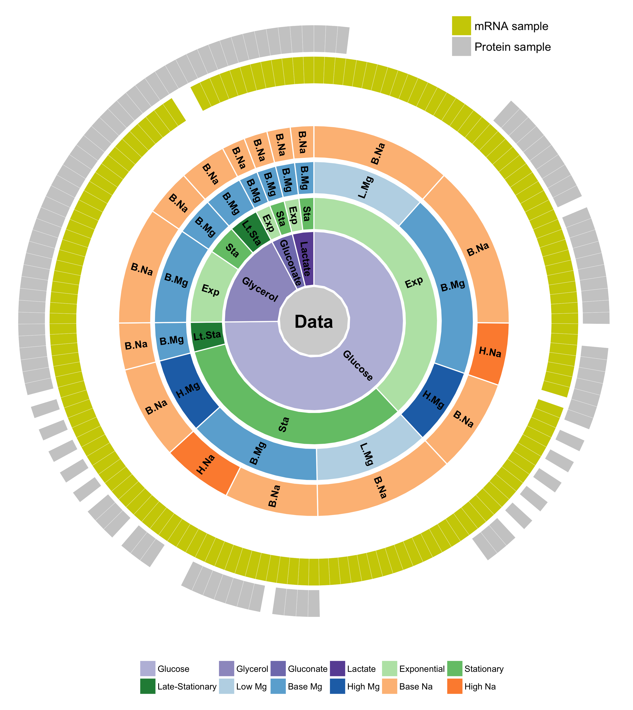
We have a large data set to learn bacterial response to external conditions

Slide 3
Q: Can we predict external conditions of bacteria growth by using machine learning technics?

Slide 4
Overall analysis approach
Samples
Dimension Reduction
Machine Learning
Prediction
Notes:
Flowchart: samples -> dimension reduction -> machine learning -> prediction
Text will be black
E-coli

Slide 5
PCA on data
Conditions: PCA axis 1&2, glucose, base Mg, base Na, exponential & stationary
Notes:
MgSO4 -> Magnesium sulfate
NaCl -> Sodium chloride

Slide 6
Machine learning: SVM with radial kernel
Conditions: PCA axis 1&2, glucose, base Mg, base Na, exponential & stationary model = "SVM", kernel = "radial", type ="C", cost=20, gamma=1/2

Slide 7
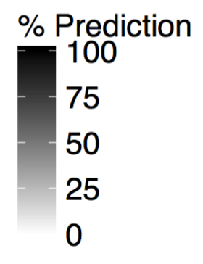
Example result
Predicted Value
A
B
C
A
True Value
B
C

Slide 8
Machine learning pipeline
INITIAL DATA PREPERATION
Find out subsets of data
Sum technical replicates
DeSeq2 -> Size factor normalization (With “+1” addition)
Log transformation (vst)
Labels
SAMPLES

Slide 9
Machine learning pipeline
INITIAL DATA PREPERATION
Find out subsets of data
Sum technical replicates
DeSeq2 -> Size factor normalization (With “+1” addition)
Log transformation (vst)
Semi-random data division
(Protect sub sample ratios)
Training set 80%
Test set 20%
Labels
Labels
SAMPLES

Slide 10
Machine learning pipeline
INITIAL DATA PREPERATION
Find out subsets of data
Sum technical replicates
DeSeq2 -> Size factor normalization (With “+1” addition)
Log transformation (vst)
Semi-random data division
(Protect sub sample ratios)
Training set 80%
Test set 20%
Labels
Batch correction object
SAMPLES
Batch Correction (fSVA)
Labels
PCA Scale = TRUE
Center = TRUE
PCA rotation object
Dim. Reduced Training 80%
Labels

Slide 11
Machine learning pipeline
INITIAL DATA PREPERATION
Find out subsets of data
Sum technical replicates
DeSeq2 -> Size factor normalization (With “+1” addition)
Log transformation (vst)
Semi-random data division
(Protect sub sample ratios)
Training set 80%
Test set 20%
Labels
Batch correction object
SAMPLES
Batch Correction (fSVA)
Labels
PCA Scale = TRUE
Center = TRUE
PCA rotation object
Dim. Reduced Training 80%
Dim. Reduced Test
20%
Labels

Slide 12
Machine learning pipeline
INITIAL DATA PREPERATION
Find out subsets of data
Sum technical replicates
DeSeq2 -> Size factor normalization (With “+1” addition)
Log transformation (vst)
Semi-random data division
(Protect sub sample ratios)
Training set 80%
Test set 20%
Labels
Batch correction object
SAMPLES
Batch Correction (fSVA)
Labels
PCA
Scale = TRUE
Center = TRUE
PCA rotation object
Dim. Reduced Training 80%
Dim. Reduced Test
20%
Labels
Train SVM
C-Classification (c = 1)
Radial Kernel (Gamma = 1/d)
Class weight normalization

Slide 13
Machine learning pipeline
INITIAL DATA PREPERATION
Find out subsets of data
Sum technical replicates
DeSeq2 -> Size factor normalization (With “+1” addition)
Log transformation (vst)
Semi-random data division
(Protect sub sample ratios)
Training set 80%
Test set 20%
Labels
Batch correction object
SAMPLES
Batch Correction (fSVA)
Labels
PCA
Scale = TRUE
Center = TRUE
PCA rotation object
Dim. Reduced Training 80%
Dim. Reduced Test
20%
Labels
Train SVM
C-Classification (c = 1)
Radial Kernel (Gamma = 1/d)
Class weight normalization
Model

Slide 14
Machine learning pipeline
INITIAL DATA PREPERATION
Find out subsets of data
Sum technical replicates
DeSeq2 -> Size factor normalization (With “+1” addition)
Log transformation (vst)
Semi-random data division
(Protect sub sample ratios)
Training set 80%
Test set 20%
Labels
Batch correction object
SAMPLES
Batch Correction (fSVA)
Labels
PCA
Scale = TRUE
Center = TRUE
PCA rotation object
Dim. Reduced Training 80%
Dim. Reduced Test
20%
Labels
Train SVM
C-Classification (c = 1)
Radial Kernel (Gamma = 1/d)
Class weight normalization
Model
Prediction

Slide 15
Machine learning pipeline
Do it 1000 times
INITIAL DATA PREPERATION
Find out subsets of data
Sum technical replicates
DeSeq2 -> Size factor normalization (With “+1” addition)
Log transformation (vst)
Semi-random data division
(Protect sub sample ratios)
Training set 80%
Test set 20%
Labels
Batch correction object
SAMPLES
Batch Correction (fSVA)
Labels
PCA
Scale = TRUE
Center = TRUE
PCA rotation object
Dim. Reduced Training 80%
Dim. Reduced Test
20%
Labels
Train SVM
C-Classification (c = 1)
Radial Kernel (Gamma = 1/d)
Class weight normalization
Model
Prediction

Slide 16
mRNA results

Slide 17
We can distinguish growth phase from mRNA data

Slide 18
We can distinguish carbon sources from mRNA data moderately. Most significant signal is associated with glucose

Slide 19
We can distinguish Mg concentrations from mRNA data. Least significant signal is associated with high Mg

Slide 20
We can NOT distinguish Na concentrations from mRNA data

Slide 21
mRNA summary

Slide 22
We can distinguish growth phase, carbon sources and Mg concentrations but not for Na concentrations from mRNA data

Slide 23
Protein data

Slide 24
We can distinguish growth phase moderately from protein data. Most significant signal is associated with exponential phase

Slide 25
We can distinguish carbon sources from protein data.

Slide 26
We can NOT distinguish Mg concentrations from protein data. Most dominant signal is associated with base Mg

Slide 27
We can NOT distinguish Na concentrations from protein data.

Slide 28
Protein summary

Slide 29
We can distinguish carbon sources and growth phase but NOT for Mg and Na concentrations from protein data

Slide 30
Exponential vs Stationary Phases

Slide 31
For mRNA data carbon sources become indistinguishable as time pass. Protein data also shows a similar but weaker trend
All Phase
Exponential
Stationary

Slide 32
For mRNA data carbon sources become indistinguishable as time pass. Protein data also shows a similar but weaker trend
All Phase
Exponential
Stationary

Slide 33
For mRNA and protein data Mg concentrations become less distinguishable as time pass.
All Phase
Exponential
Stationary

Slide 34
For mRNA and protein data Mg concentrations become less distinguishable as time pass.
All Phase
Exponential
Stationary

Slide 35
For mRNA data Na become less distinguishable as time pass. For proteins Na is not distinguishable.
All Phase
Exponential
Stationary

Slide 36
For mRNA data Na become less distinguishable as time pass. For proteins Na is not distinguishable.
All Phase
Exponential
Stationary

Slide 37
More complex examples

Slide 38
For mRNA data, prediction works quite well

Slide 39
For protein data, prediction quality is slightly worse

Slide 40
Combining data

Slide 41
Proteins are strong in carbon sources Diagonal sum: 842

Slide 42
mRNA is bad in stationary phase Diagonal sum: 749

Slide 43
Combined data (mRNA + protein) have no synergistic effects Diagonal sum: 888

Slide 44
We can look at the same data with regression

Slide 45
Machine learning pipeline
Do it 1000 times
INITIAL DATA PREPERATION
Find out subsets of data
Sum technical replicates
DeSeq2 -> Size factor normalization (With “+1” addition)
Log transformation (vst)
Semi-random data division
(Protect sub sample ratios)
Training set 80%
Test set 20%
Labels
Batch correction object
SAMPLES
Batch Correction (fSVA)
Labels
PCA
Scale = TRUE
Center = TRUE
PCA rotation object
Dim. Reduced Training 80%
Dim. Reduced Test
20%
Labels
Train SVM
C-Classification (c = 1)
Radial Kernel (Gamma = 1/d)
Class weight normalization
Model
Prediction

Slide 46
Machine learning pipeline
Do it 1000 times
INITIAL DATA PREPERATION
Find out subsets of data
Sum technical replicates
DeSeq2 -> Size factor normalization (With “+1” addition)
Log transformation (vst)
Semi-random data division
(Protect sub sample ratios)
Training set 80%
Test set 20%
Labels
Batch correction object
SAMPLES
Batch Correction (fSVA)
Labels
PCA
Scale = TRUE
Center = TRUE
PCA rotation object
Dim. Reduced Training 80%
Dim. Reduced Test
20%
Labels
Train SVM
C-Classification (c = 1)
Radial Kernel (Gamma = 1/d)
Class weight normalization

Slide 47
Machine learning pipeline with parameter tuning
Do it 1000 times
INITIAL DATA PREPERATION
Find out subsets of data
Sum technical replicates
DeSeq2 -> Size factor normalization (With “+1” addition)
Log transformation (vst)
Semi-random data division
(Protect sub sample ratios)
Training set 80%
Test set 20%
Labels
Batch correction object
SAMPLES
Batch Correction (fSVA)
Labels
PCA
Scale = TRUE
Center = TRUE
PCA rotation object
Dim. Reduced Training 80%
Dim. Reduced Test
20%
Labels
Train SVM with Tuning
eps-regression (c = from grid)
Radial K. (Gamma = from grid)
Class weight normalization

Slide 48
Machine learning pipeline with parameter tuning
Do it 1000 times
INITIAL DATA PREPERATION
Find out subsets of data
Sum technical replicates
DeSeq2 -> Size factor normalization (With “+1” addition)
Log transformation (vst)
Semi-random data division
(Protect sub sample ratios)
Training set 80%
Test set 20%
Labels
Batch correction object
SAMPLES
Batch Correction (fSVA)
Labels
PCA
Scale = TRUE
Center = TRUE
PCA rotation object
Dim. Reduced Training 80%
Dim. Reduced Test
20%
Labels
Train SVM with Tuning
eps-regression (c = from grid)
Radial K. (Gamma = from grid)
Class weight normalization

Slide 49
Machine learning pipeline with parameter tuning
Dim. Reduced Training 80%
Labels
Do it 1000 times
INITIAL DATA PREPERATION
Find out subsets of data
Sum technical replicates
DeSeq2 -> Size factor normalization (With “+1” addition)
Log transformation (vst)
Semi-random data division
(Protect sub sample ratios)
Training set 80%
Test set 20%
Labels
Batch correction object
SAMPLES
Batch Correction (fSVA)
Labels
PCA
Scale = TRUE
Center = TRUE
PCA rotation object
Dim. Reduced Training 80%
Dim. Reduced Test
20%
Labels
Train SVM with Tuning
eps-regression (c = from grid)
Radial K. (Gamma = from grid)
Class weight normalization

Slide 50
Machine learning pipeline with parameter tuning
Dim. Reduced Training 80%
Labels
Do it 1000 times
INITIAL DATA PREPERATION
Find out subsets of data
Sum technical replicates
DeSeq2 -> Size factor normalization (With “+1” addition)
Log transformation (vst)
Semi-random data division
(Protect sub sample ratios)
Random data division
Training set 80%
Test set 20%
Training set 60%
Test set 20%
Labels
Batch correction object
SAMPLES
Batch Correction (fSVA)
Labels
PCA
Scale = TRUE
Center = TRUE
PCA rotation object
Dim. Reduced Training 80%
Dim. Reduced Test
20%
Labels
Train SVM with Tuning
eps-regression (c = from grid)
Radial K. (Gamma = from grid)
Class weight normalization

Slide 51

Machine learning pipeline with parameter tuning
Dim. Reduced Training 80%
Labels
Do it 1000 times
INITIAL DATA PREPERATION
Find out subsets of data
Sum technical replicates
DeSeq2 -> Size factor normalization (With “+1” addition)
Log transformation (vst)
Semi-random data division
(Protect sub sample ratios)
Random data division
Training set 80%
Test set 20%
Training set 60%
Test set 20%
Labels
Batch correction object
SVM
Parameters from grid. (c, gamma)
Batch Correction (fSVA)
Labels
SAMPLES
Model_{(c,}$γ$₎
PCA
Scale = TRUE
Center = TRUE
PCA rotation object
Dim. Reduced Training 80%
Dim. Reduced Test
20%
Labels
Train SVM with Tuning
eps-regression (c = from grid)
Radial K. (Gamma = from grid)
Class weight normalization

Slide 52
Machine learning pipeline with parameter tuning
Dim. Reduced Training 80%
Labels
Do it 1000 times
INITIAL DATA PREPERATION
Find out subsets of data
Sum technical replicates
DeSeq2 -> Size factor normalization (With “+1” addition)
Log transformation (vst)
Semi-random data division
(Protect sub sample ratios)
Random data division
Training set 80%
Test set 20%
Training set 60%
Test set 20%
Labels
Batch correction object
SVM
Parameters from grid. (c, gamma)
Batch Correction (fSVA)
Labels
SAMPLES
Model_{(c,}$γ$₎
Parameter dependent prediction
PCA
Scale = TRUE
Center = TRUE
PCA rotation object
Dim. Reduced Training 80%
Dim. Reduced Test
20%
Labels
Train SVM with Tuning
eps-regression (c = from grid)
Radial K. (Gamma = from grid)
Class weight normalization

Slide 53
Machine learning pipeline with parameter tuning
15 x 15 x 20 runs
Dim. Reduced Training 80%
Labels
Do it 1000 times
INITIAL DATA PREPERATION
Find out subsets of data
Sum technical replicates
DeSeq2 -> Size factor normalization (With “+1” addition)
Log transformation (vst)
Semi-random data division
(Protect sub sample ratios)
Random data division
Training set 80%
Test set 20%
Training set 60%
Test set 20%
Labels
Batch correction object
SVM
Parameters from grid. (c, gamma)
Batch Correction (fSVA)
Labels
SAMPLES
Model_{(c,}$γ$₎
Parameter dependent prediction
PCA
Scale = TRUE
Center = TRUE
PCA rotation object
Best
Model
Dim. Reduced Training 80%
Dim. Reduced Test
20%
Labels
Train SVM with Tuning
eps-regression (c = from grid)
Radial K. (Gamma = from grid)
Class weight normalization

Slide 54
Machine learning pipeline with parameter tuning
Do it 1000 times
INITIAL DATA PREPERATION
Find out subsets of data
Sum technical replicates
DeSeq2 -> Size factor normalization (With “+1” addition)
Log transformation (vst)
Semi-random data division
(Protect sub sample ratios)
Training set 80%
Test set 20%
Labels
Batch correction object
SAMPLES
Batch Correction (fSVA)
Labels
PCA
Scale = TRUE
Center = TRUE
PCA rotation object
Dim. Reduced Training 80%
Dim. Reduced Test
20%
Labels
Train SVM with Tuning
eps-regression (c = from grid)
Radial K. (Gamma = from grid)
Class weight normalization

Slide 55
Machine learning pipeline with parameter tuning
Do it 1000 times
INITIAL DATA PREPERATION
Find out subsets of data
Sum technical replicates
DeSeq2 -> Size factor normalization (With “+1” addition)
Log transformation (vst)
Semi-random data division
(Protect sub sample ratios)
Training set 80%
Test set 20%
Labels
Batch correction object
SAMPLES
Batch Correction (fSVA)
Labels
PCA
Scale = TRUE
Center = TRUE
PCA rotation object
Dim. Reduced Training 80%
Dim. Reduced Test
20%
Labels
Train SVM with Tuning
eps-regression (c = from grid)
Radial K. (Gamma = from grid)
Class weight normalization
Best
Model

Slide 56
Machine learning pipeline with parameter tuning
Do it 1000 times
INITIAL DATA PREPERATION
Find out subsets of data
Sum technical replicates
DeSeq2 -> Size factor normalization (With “+1” addition)
Log transformation (vst)
Semi-random data division
(Protect sub sample ratios)
Training set 80%
Test set 20%
Labels
Batch correction object
SAMPLES
Batch Correction (fSVA)
Labels
PCA
Scale = TRUE
Center = TRUE
PCA rotation object
Dim. Reduced Training 80%
Dim. Reduced Test
20%
Labels
Train SVM with Tuning
eps-regression (c = from grid)
Radial K. (Gamma = from grid)
Class weight normalization
Best
Model
Prediction

Slide 57
Example Result

Slide 58
Example Result

Slide 59
Example Result

Slide 60
Example Result

Slide 61
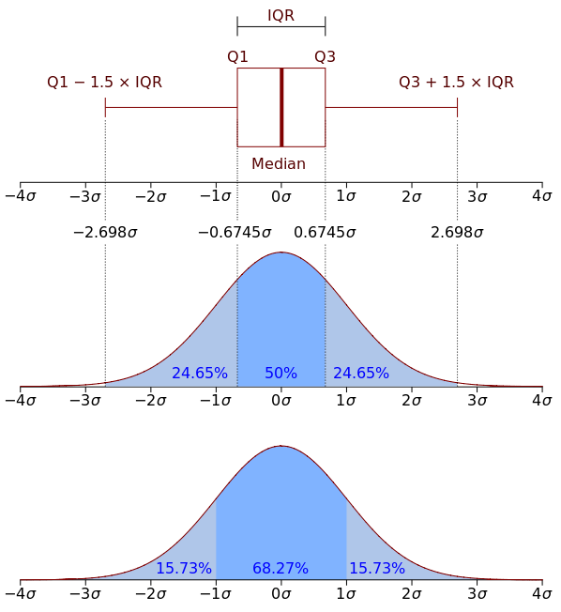
Example Result

Slide 62
Example Result
Mean Value
Notes:
IQR: Interquartile Range

Slide 63
Growth time we can make predictions on continuous scale

Slide 64
For mRNA data, Mg concentrations is predictable with a tendency to base value, for proteins there is only a weak signal.

Slide 65
For varying Na concentrations, mRNA data is predictable, but protein data is not

